Slide 1
Negative Ego Defense Mechanisms
Regression
Reaction Formation
Temporary reverting of the ego to an earlier stage of development rather than handling unacceptable impulses in a more adult way.
Person behaves in the opposite way to which he/she thinks or feels.
Eg: A drug addict preaches against substance abuse.
Eg: A child may begin to suck their thumb again or wet the bed when needed to spend some time in the hospital.

Slide 2
Suppression
Projection
Consciously removing distressing thoughts, emotions, memories, fantasies, and desires from awareness.
Taking own unacceptable qualities or feelings and putting such qualities on other people (blaming others).
Eg: Deciding not to think about a loved one's death or a relationship breakup.
Eg: An incompetent surgeon whose patient does not respond well to the treatment may tend to blame nurses for patient's condition.

Slide 3
Negativism
Denial
involves a person developing an irrational resistance to accepting suggestions from others.
Simplest and most primitive defense mechanism.
Subjects refuse to accept threatening and anxiety provoking external reality to reduce the anxiety.
They refuse to attack the problems or obstacles which confront them.
Eg: Patient denying the diagnosis of cancer and seeking a second opinion.
Instead, they become contradictory, stubborn and rebellious.
They become uncooperative and do the opposite of what should be done.
This type of behaviour is commonly seen in children and sick persons.

Slide 4
Fantasy
Withdrawal
Satisfying frustrated desires by imaginary achievement to resolve inner and outer conflicts.
Removing oneself from the events, stimuli, interactions, that could remind one of painful thoughts and feelings.
Eg: A lazy and incompetent employee Imagines to be awarded as employee of the year in an organization.
Eg: A person block his Facebook account to avoid painful memories related to his late wife.

Slide 5

Frustration
The term frustration has derived from the Latin word "Frusta' meaning 'obstruct'.
The feeling of being upset or annoyed as a result of being unable to change or achieve something creates frustration.
It occurs when our motives are blocked or thwarted from reaching our goals.
Definitions
Frustration is the blocking or interference of the satisfaction of an aroused need through some barriers or obstruction. -Symonds
Frustration means emotional tension resulting from the blocking of a desire or need. -Good

Slide 6
Characteristics of Frustration
1
It produces an unpleasant emotional state (anger, despair, irritation and anxiety).
2
Failure dominates attempts.
3
Major obstacle in satisfaction of one's basic needs or goals.
4
Significance of the goal and strength of blockade increases degree.
5
Cause lies in individual and environment.

Slide 7
Causes of Frustration
External Factors
Internal Factors
External factors: These are environmental factors, which causes frustration. Such as:
These are personal factors that lads to frustration.
a. Physical factors: Natural calamities and environmental situations, which we cannot control.
a. Physical abnormalities or defects.
b. Conflicts of motives within the individual.
c. Morality and high ideals.
For example, death of loved one.
d. High levels of aspiration.
b. Social factors: Conflict with people, customs, laws, etc.
e. Lack of persistence and sincerity.
c. Economic factors: Financial loss.

Slide 8
Types of Frustration
Internal Frustration
External Frustration
This type of frustration results within the individual, due to personal inadequacies and when person have competing goals.
It involves the condition which exists outside the individual and he cannot control.
Example: Standing in line, in traffic, roadblocks.
Example: Lack of confidence, fear of social rejection.

Slide 9

Measures to overcome Frustration
Frustration should be managed because unresolved frustration can lead to development of psychosomatic disorders. Steps to resolve frustration are:
Review the situation
Change goals
Choose alternative ways

Slide 10

Conflict
The word conflict has been derived from Latin word Conflict' which means "strike two things at the same time".
Conflict is an opposition between contradictory impulses or thoughts.
When there is disturbance in preferable state of harmony and stability in interdependent world, conflict arises.
Conflict is an important source of frustration.
It results when two or more motives and drives are there.

Slide 11
A conflict is the anticipated frustration entailed in the choice of either alternative.-Colman.
It can be sharp disagreement between ideas, purposes or interests within an individual or between two individuals.
Conflicts generally results in heated arguments, verbal and even physical abuses.
Conflicts between groups, communities and nations can cause death, population displacement, destruction of materials and disruption of social and economic systems.

Slide 12
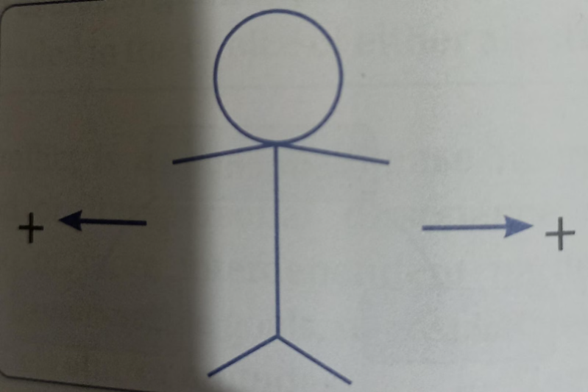
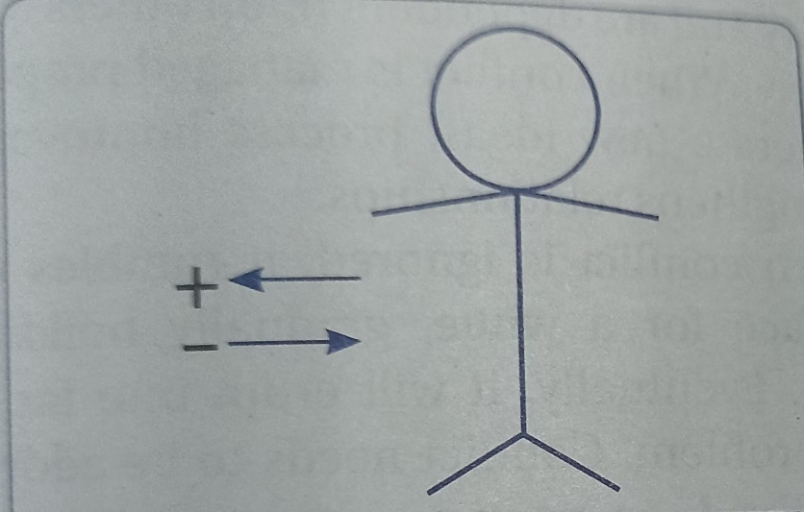
Types of Conflicts
Approach-Approach Conflict
Approach-Avoidance Conflict
This conflict arises when a person faces the problem of selecting among two or more equally attractive goals which are mutually exclusive.
This conflict arises when a person has an alternative which has both positive and negative aspects.
Conflict arises in the mind of the person because he/ she can choose only one alternative at the cost of other equally positive alternative.
Eg:- a person gets job opportunity but at a place which he does not like. Therefore, he feels a conflict as he has got a job (positive aspect) but does not like the place of job (negative aspect).
Eg:- Choosing between two attractive vacation destinations.

Slide 13
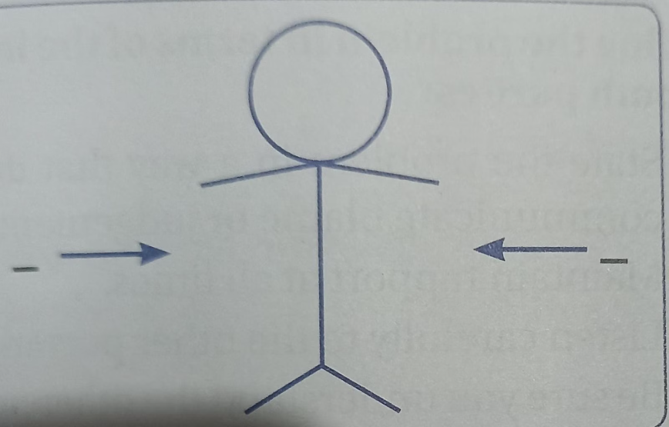
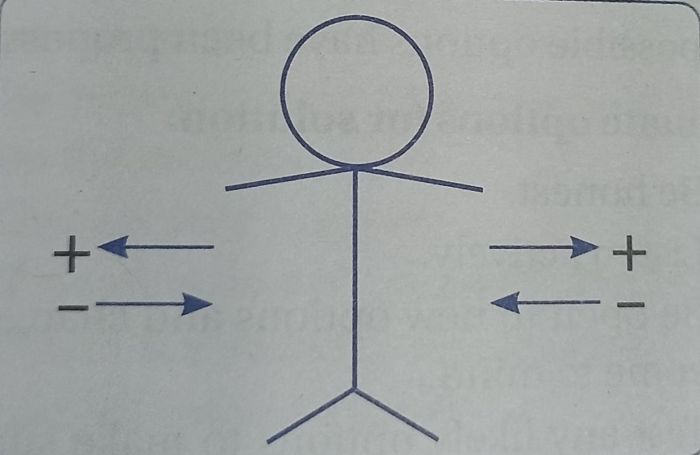
Avoidance-Avoidance Conflict
Multiple Approach-Avoidance Conflict
This conflict arises when a person has to choose between two mutually exclusive goals, each of which possesses equally negative aspect.
A person has to choose between two or more alternatives, each of which has both positive and negative features.
In such a case, unless another alternative is available, the conflict remains unresolved.
This is the most difficult conflict to resolve and to make the right decision.
Eg:-Choosing between unemployment and a salary cut.
Eg:- individual who wants to do higher education or to get married.

Slide 14
Measures to overcome Conflict
The Thomas-Kilmann conflict model explains about handling a conflict.
Accommodating: This conflict management technique allows individual to cooperate at high degree but without assertiveness.
This approach is effective for preserving future relations with others.
Avoiding: This style employ complete avoidance of situations. This style works for a trivial issue and when there is no chance of winning. In this, there is no assertiveness and no cooperativeness.
This style is effective when conflict upset emotionally.
Collaborating: This style may be used when persons involved in the conflict ready to work with each other to achieve the goals. This style is used to seek 'win-win' paradigm.
In this style, assertiveness and cooperation are high.
Competing: This style is based on 'win-lose' strategy. This approach requires high level of assertiveness without cooperation.
This is effective when there is need to take quick decision.
Compromising: This is the 'lose-lose' strategy where neither they achieve that they really wants to achieve. This has moderate level of assertiveness and cooperation.
There is need of temporary solution when both the individuals have equally important goals.

Slide 15
Role of nurse in reducing frustration
Assess the cause of patient's frustration.
Do not be provocative.
Be concise-Use simple words as possible.
Identify wants and feelings of patients.
Listen closely to what patient is saying.
Teach healthy life style techniques- meditation, progressive muscle relaxation technique etc.

Slide 16
Role of nurse in reducing conflict
Identify potential conflict.
Maintain therapeutic relationship with patient.
Develop an implementation plan- use Thomas-Kilmann conflict model.
Evaluate entire process of conflict resolution-whether it is resolved or not.
Role of nurse in enhancing coping
Teach the patient problem focused Intervention- identify the problem causing distress and solve.
Teach the patient emotion focused intervention- reduce the negative emotions related to problem.
Teach the patient meaning focused intervention- involves finding meaning in stressful situation by drawing on own beliefs and values.
Teach the patient social coping.
Teach the client new coping skills.
Assign home assignments to patient.

Slide 17
Dealing with Ego
The ego is described as the "world's most powerful psychological agency".
According to psychology, the ego evolves and changes throughout one's life as a result of interactions with the social and physical world.
Individuals with chronic and severe ego deficits should use an ego supportive approach, so ego supportive treatment can help them develop positive ego functions and ego strengths.
Most significant goals of ego support are:-
Support and restore ego.
Maintain and enhance individual's adaptive functions.
Strengthening and building ego where there are deficits and impairments.
Promote the use of higher levels of ego defense.

Slide 18
Ego Supportive Interventions
When we start to believe that we are special and that no one else is like us, we lose our potential to be genuinely creative. This is referred to as poisonous ego.
It is important to keep toxic ego and selfishness away.
Followings are the techniques with that one can deal with toxic ego effectively and keep oneself creative and humble:-
Adopt the beginner's mindset: With this one can remain free from social pressure and develop open mindset who is always ready to learn from the mistakes.
Focus on the effort not the outcome: Do your best that is what matters and external rewards are just extra.
Choose purpose over passion: Passion alone causes frustration and burnout, whereas passion combined with reason makes one more dedicated and have control over their direction.
Leave the comfort zone: People talk endlessly on social media getting validation and attention with fake internet points and avoiding the uncertainty of doing the challenging work.
Kill pride: You must remember that humility is the antidote to pride.

Slide 19
Learn to manage success: When one achieve success and think that success in the future is just the natural and expected every time. This is a straightforward path to failure and disappointment hence one must always focus on the present moment.
Focused and avoid distraction: One need to understand his/her priorities and reject all the distraction.
Let go of control: One must remember themselves of the limits of their authority and reach.
Help subordinates: Help team member professionally and personally.
Active listening: listen to understand, not to reply. This will help one learn new things too.
Step down if required: Stepping down definitely helps in curbing the ego and facing reality.
Be empathetic: it is better to see things from both sides of the spectrum. This way, one can make a fair decision.
Stop complaining: If you look at life positively, it is great. So, instead of moaning, be grateful for what you have. That will help you stay grounded.

